Slide 1
Overview of Maryland EMS Benjamin J. Lawner, DO, MS, EMT-P Assistant Professor, Department of Emergency Medicine University of Maryland School of Medicine

Slide 2
Objectives
Understand different types of EMS providers
Review training required for each EMS certification level
Discuss organization of EMS at the state level
Recognize your EMS faculty physicians and their roles in prehospital and disaster medicine

Slide 3
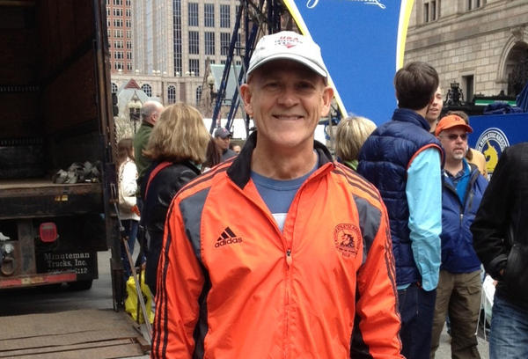
Dr. Wade Gaasch
Medical Director, Baltimore City Fire Department
Medical Director, University of Maryland ExpressCare
Medical Director, Baltimore City Police Department Tactical Team

Slide 4
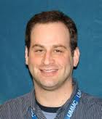
Dr. Ben Lawner
Deputy Medical Director, Baltimore City Fire Department
Medical Director, University of Maryland Baltimore County Critical Care Transport Course
Medical Director, CCBC Emergency Medical Technology Program

Slide 5
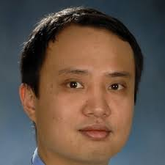
Dr. JV Nable
Attending Physician at MedStar Georgetown University Hospital
Medical Specialist, Maryland Task Force 1 Urban Search and Rescue Team

Slide 6
Dr. Debra Lee
Co-Director, UMMC/MIEMSS/UMBC emergency medical services fellowship
Medical Director, Mercy Medical Center Base Station

Slide 7
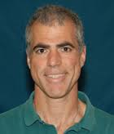
Dr. Douglas Floccare
Medical Director, Maryland State Police Aviation Command

Slide 8
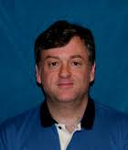
Dr. Roger Stone
Medical Director, Montgomery County Department of Fire Rescue Services

Slide 9
EMS Provider Types

Slide 10
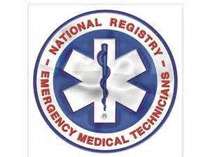
Emergency Medical Technician

Slide 11
Emergency Medical Technician
160-300 hours
Non invasive skills
Patient assisted medication
Patient assessment / advanced first aid
Minimum qualifications for ambulance crew
Courses offered at Johns Hopkins University undergraduate campus, local community colleges, and at fire departments

Slide 12
Emergency Medical Technician
Delivers “BLS” or basic life support
Additional skills available depending upon jurisdiction and population based needs
In Western Maryland, EMT’s can obtain and transmit 12 lead ECGs

Slide 13
The Advanced/Intermediate EMT

Slide 14
Advanced/Intermediate EMT
“Paramedic” level skills
600-1000 hours
Internship/fire academy training
Minimum level of ALS
Majority of BCFD apparatus staffing
“Advanced Emergency Medical Technicians”

Slide 15
Advanced EMT Skills
IV access
ECG interpretation
Medication administration
Supraglottic airway placement

Slide 16
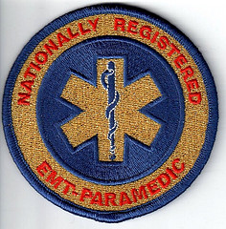
The Nationally Registered Paramedic

Slide 17
Nationally Registered Paramedic
Highest level of ALS training
1200-2000 hours
Supervised field internship
Advanced assessment/skills

Slide 18
Nationally Registered Paramedic
Must graduate from accredited program
Typically 3 semesters + EMT
Training leads to certificate or degree
Link in the health care system
Able to formulate focused field diagnoses

Slide 19
Specialty Care Providers

Slide 20
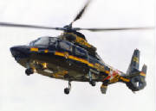
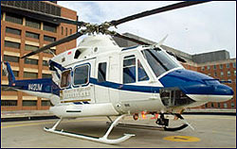
Specialty Care Providers

Slide 21
Critical / Specialty Care Paramedics
Participate in interfacility transfers
Additional training in medication infusions
Enhanced scope of practice
May work with RN, RT, physicians
Ventilator management
In Maryland, “specialty care transport” considerations apply to patients with advanced in-transport medical needs

Slide 22
Critical/Specialty Care Paramedics
No uniform standard of training
Typically regulated by state or jurisdiction
National organizations suggest minimum standards
Voluntary certification
Critical care transport providers

Slide 23
Maryland State Police: Aviation Command
State funded
Provides scene response and medical transport for ill and injured
7 geographically located helicopter bases
Staffed with police paramedics
Twin engine AW139 and Dauphin helicopters
Majority of missions are trauma response

Slide 24
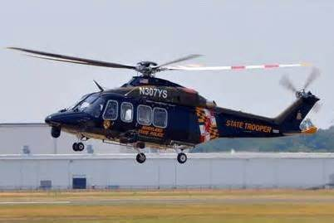
Aviation Command
Centralized dispatch system
Expedited transport to definitive care
Also performs select law enforcement and rescue missions
No transport fee charged to Maryland citizens
Established protocols for requesting medevac assistance

Slide 25
EMS Oversight in Maryland

Slide 26
Regionalized care
Oversight
Quality assurance
Independent agency

Slide 27
State divided into 5 regions
Regional councils and medical directors
State EMS board comprised of stakeholders
Articulation of policy and protocols
EMS regulations
Administration of medevac operations (MSP)

Slide 28
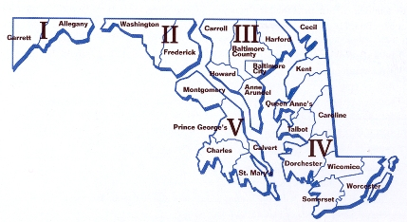
Baltimore City is in MIEMSS Region III

Slide 29
EMS Physicians
Subspecialty training
9 months minimum
Field operations
Tactical medicine
Mass gathering medicine
Provider training
Communications
Disaster mitigation / managment

Slide 30
EMS Physicians
Operational medical direction
Administrative medical direction
Online vs. offline medical control
Onscene response
Disaster planning

Slide 31
EMS Physician Responsibility
Resident EMS rotation
EMS specific curriculum
Senior student and resident electives
Hospital based medical control
Prehospital quality assurance

Slide 32
Rotation Basics

Slide 33
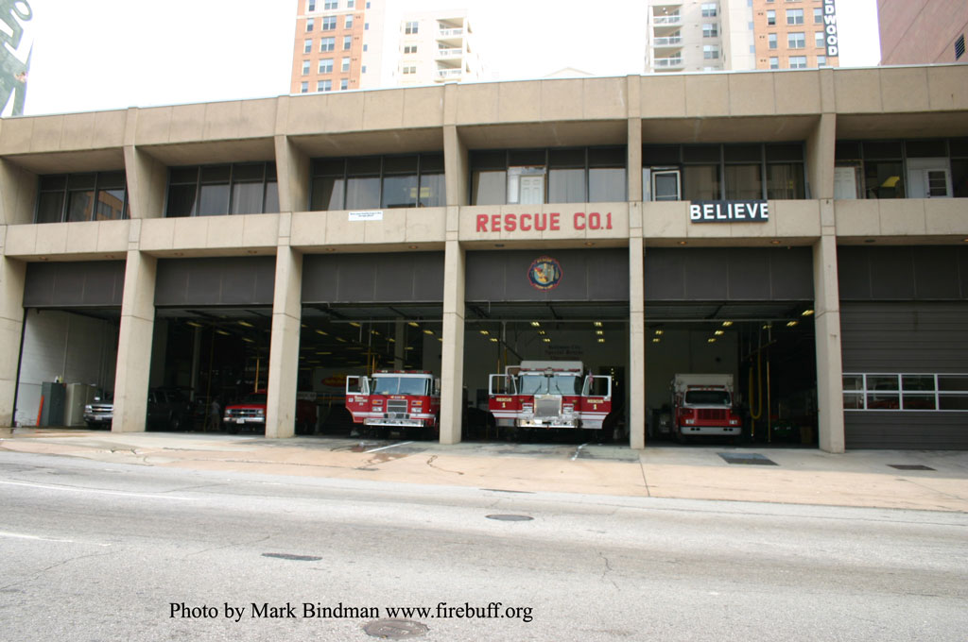
The Steadman Station

Slide 34
Steadman Station: Apparatus
Lombard/Eutaw streets
Houses 3 ALS medic units (M1,M22,M23)
EMS supervisor (EMS-2)
ALS engine (E-23)
Heavy rescue company (R-1)
Hazmat and decon task force
Air cascade unit
Specialty response units (collapse rescue)

Slide 35
Steadman Station: Reporting Procedure
Ask for the on-duty EMS supervisor
The supervisor will assign you to a unit or to the supervisor’s own response vehicle
Ambulances may be out at the hospital or on scene
The supervisor will advise the crew that you are in station

Slide 36
Steadman Station: Uniform
Polo or scrub shirt
Khaki, BDU, or scrub pants
University of Maryland ID
Stethoscope
Money for food (fire station dinner $5-10)
Closed toe shoes
Compliance with University of Maryland School of Medicine dress code

Slide 37
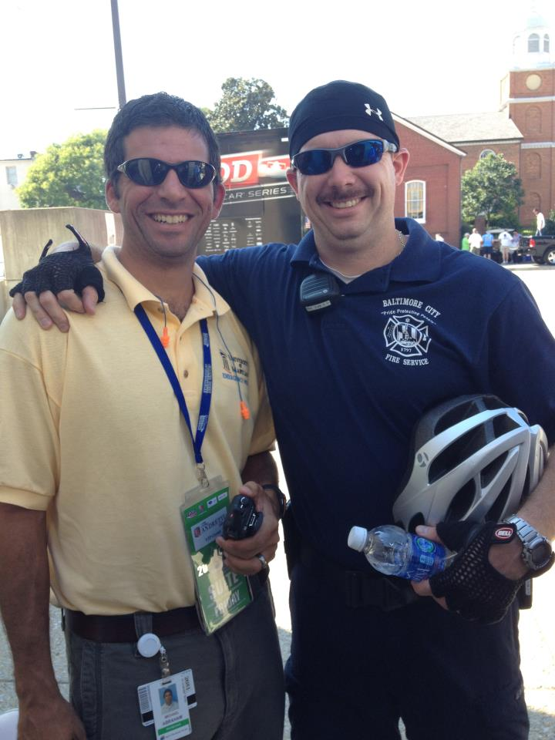

Slide 38
How to Get Involved
Observation shifts
Ride A Longs
Elective
Next steps

Slide 39
Thank You!
Blawn001@umaryland.edu

